Slide 1

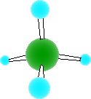
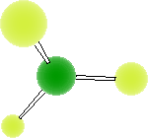

Shapes of
Molecules

Slide 2
The shape of a molecule is predicted using the
Valence Shell Electron Pair Repulsion model :-
consider all electron pairs in the valence shell – both bonded & non-bonded of the central atom
These electron pairs repel each other & try to get as far away from each other as possible

Slide 3
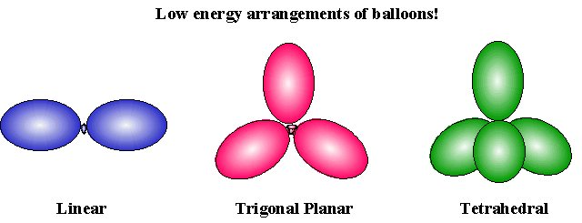
Valence Shell Electron Pair Repulsion model
A balloon analogy
When tied together, the balloons push each other as far apart as possible
180º separation 120º separation 109.5º separation

Slide 4
Resulting Molecule Shapes
as follows.....

Slide 5
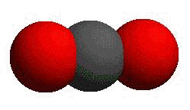
Linear Molecules
Eg. Carbon dioxide 2 double bonds repelling each other, maximum separation will be 180º.
O
C
O

Slide 6
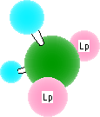
Bent (v-shaped) Molecules
Eg. Water 2 bonded pairs and 2 lone pairs of electrons repelling each other.
O
H
H
Repulsion from lone pairs is slightly greater so the angle between the bonds is slightly less than 109.5º
104.5º
Lone pairs of electrons also repel others

Slide 7

Triangular Planar Molecules
Eg. Boron trifluoride
This is a special case since boron does not obey the octet rule in this example. The central boron atom has only 3 outer electrons – all are involved in the 3 single covalent bonds. Maximum angle separation of 3 bonds is 120º.
There are no unpaired electrons.
120º

Slide 8

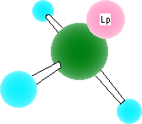
Pyramidal Molecules
Eg. Ammonia 3 bonded pairs and 1 lone pair of electrons repelling each other.
Repulsion from lone pairs is slightly greater so the angle between the bonds is slightly less than 109.5º
107º

Slide 9


Tetrahedral Molecules
Eg. Methane 4 bonded pairs of electrons repelling each other. No un-bonded pairs.
The central carbon atom has only 4 outer electrons – all are involved in the 4 single covalent bonds. Each of the bonded pairs repels equally so the ideal maximum angle separation of 4 bonds is achieved ie. 109.5º
109.5º

Slide 10
http://www.uwosh.edu/faculty_staff/xie/tutorial/vsepr.htm
3-d

